Slide 1

PRODUCT DEMO & TECH DEEP-DIVE
FINSI FINANCIAL SUPER INTELLIGENCE
AI-powered investment copilot for Indian equity intelligence. Multi-agent AI + portfolio-aware decision support.

Slide 2




THE FRAGMENTED MARKET PROBLEM
INFORMATION OVERLOAD
DISCONNECTED WORKFLOW
Retail investors face raw data dumps without synthesis. Price charts, filings, and news are isolated, leading to analysis paralysis and missed signals.
Generic research tools aren't portfolio-aware. Interpreting a BSE filing's impact on a specific holding requires manual, error-prone effort.

Slide 3
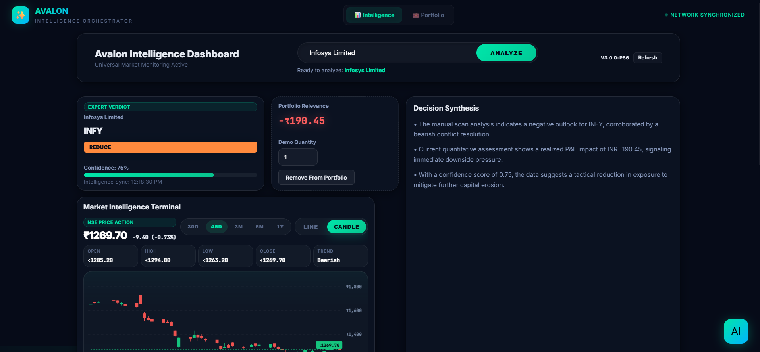

THE FINSI ECOSYSTEM
UNIFIED DECISION WORKFLOW
FinSI combines market data, technical indicators, and portfolio awareness into a single, cohesive terminal.
→
One-Click Analysis: Instant expert verdicts
→
Contextual Signals: Bullish/Bearish reasoning
→
Embedded Copilot: Follow-up via Gemini
→
Portfolio Bridge: Signals mapped to holdings

Slide 4
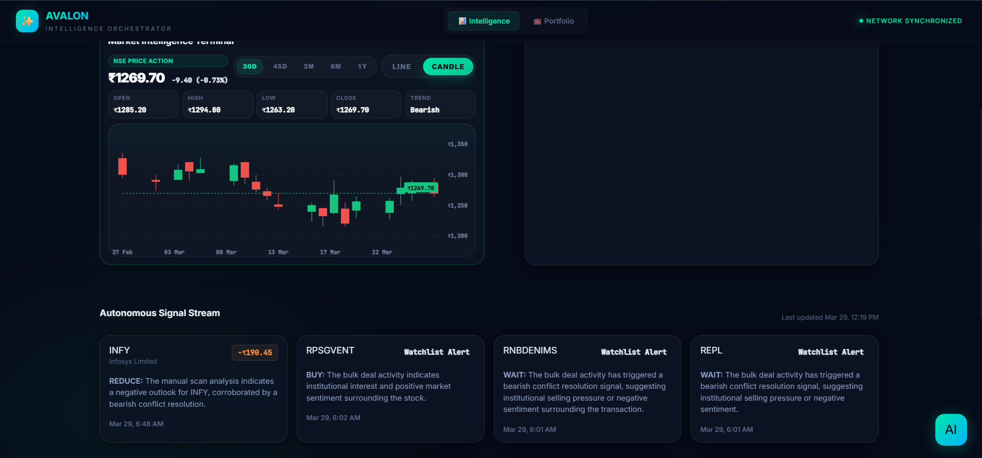

Slide 5
HOW THE USER JOURNEY WORKS
01. DISCOVERY
02. AI SCRUTINY
03. INTEL DELIVERY
04. PORTFOLIO ACTION
05. DEEP-DIVE
User searches for a stock or Indian company ticker.
Multi-agent pipeline runs automated analysis.
Dashboard displays verdict, chart, and relevance.
Ask follow-up questions to the Gemini Copilot.
Add/Remove stocks from demo holdings.

Slide 6
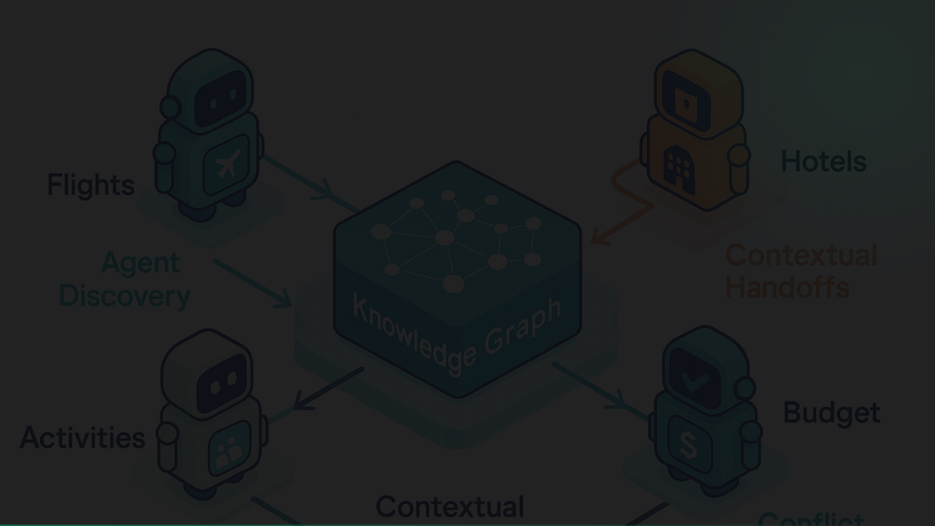

ARCHITECTURE: THE REASONING ENGINE
REASONING DESIGN
CORE STACK
→
The frontend remains thin for high performance.
Frontend: React + Vite (Modern SPA) Backend: FastAPI (Asynchronous Orchestration) AI: Gemini 3.1 Flash (Main Reasoning) Storage: SQLite + ChromaDB (Vector Search)
→
Backend owns the reasoning and signal generation.
→
ChromaDB enables RAG-based context enrichment.
→
yfinance and NSE provide the data backbone.

Slide 7






7-AGENT REASONING PIPELINE (I)
SIGNAL RADAR
CHART INTEL
CONTEXT ENRICH
Detects initiating events and enriches scans with real-time news context.
Calculates RSI, trends, and 52-week positioning technicals.
Pulls company filing data through vector retrieval (RAG).

Slide 8






7-AGENT REASONING PIPELINE (II)
CONFLICT RESOLVER
PORTFOLIO AGENT
ACTION GEN
Resolves contradictory signals into a definitive net direction.
Maps findings directly to the user's current equity holdings.
Generates the final verdict, reasoning, and output payload.

Slide 9
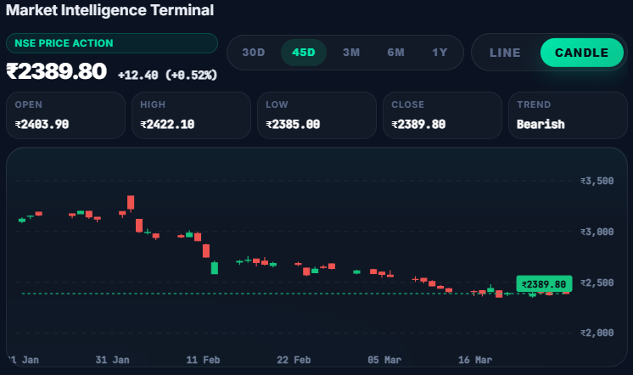
TERMINAL DESIGN LANGUAGE
DECISION-READY UI
Designed like a brokerage-inspired terminal for high feature density and rapid interpretation.
→
Autonomous signal alert stream
→
Multi-mode candlestick charts
→
AI Verdict & Confidence cards
→
Synthesis panels for deep context

Slide 10
PORTFOLIO-AWARE SUPPORT
NOT ALL SIGNALS ARE EQUAL
1:1
FinSI contextualizes every market movement based on your skin in the game.
→
Detects holdings and average buy price.
→
Calculates estimated impact on portfolio value.
SIGNAL MAPPING
→
Flags risks specific to current exposure.

Slide 11
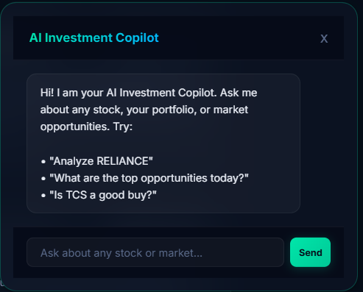
GEMINI 3.1 POWERED COPILOT
ANALYSIS-AWARE CHAT
Unlike generic LLMs, the embedded FinSI copilot reasons over the live app state.
→
Reasons over latest saved analysis snapshots.
→
Contextualized by portfolio holdings.
→
Uses Gemini 3.1 Flash for rapid, low-latency reasoning.
→
Fetches recent web results for late-breaking news.

Slide 12

FinSI
Transforming fragmented Indian market data into explainable, portfolio-aware AI intelligence.
From ticker search to expert verdict.
Questions?

